Slide 1
Interrupt

Slide 2
Polling vs Interrupt
There are many ways to structure the flow of the application:
Polling
Waste CPU’s processing time and energy
Most of the time, nothing changes
Interrupt
Specific type of an exception
Exception is a hardware-invoked subroutine call.
Subroutine is called an Interrupt Service Routine (ISR) or Interrupt handler.
2

Slide 3
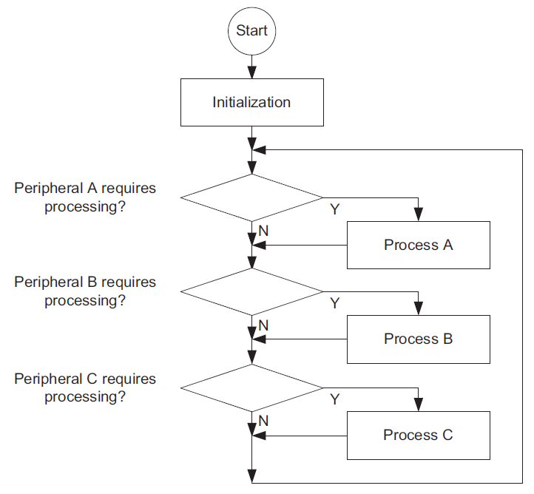
Polling
Polling (sometimes also called super loop) is easy to set up and works fairly well for simple tasks
3

Slide 4
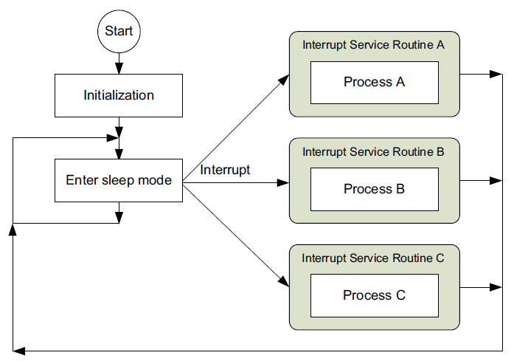
Interrupt
Interrupts are usually generated by external sources or on chip peripherals to wake up the processor.
4

Slide 5
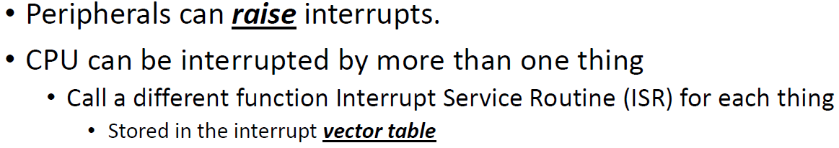
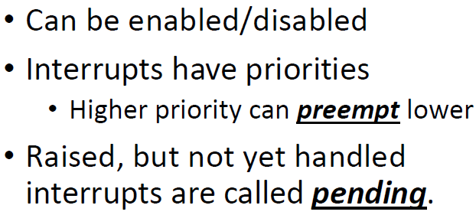
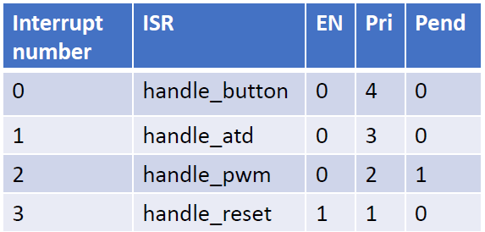
Interrupt Basics
5

Slide 6
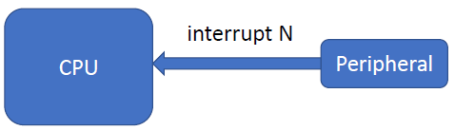



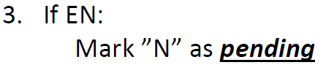
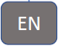
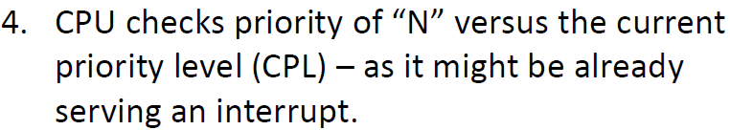


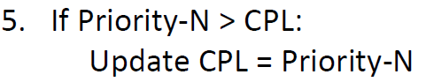

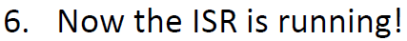
Flow of an Interrupt
6

Slide 7
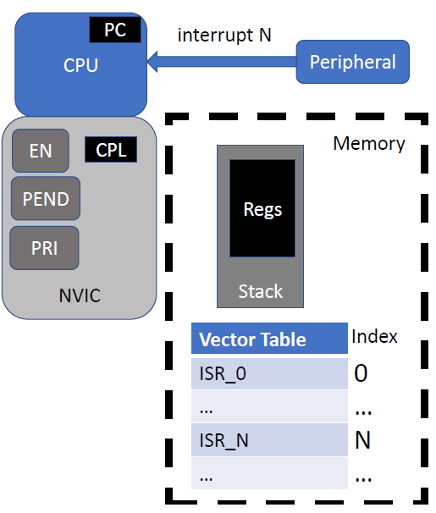

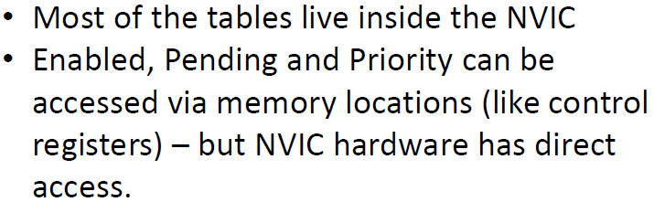
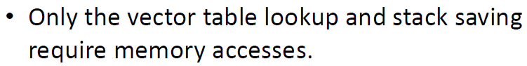
Flow of an Interrupt
7

Slide 8

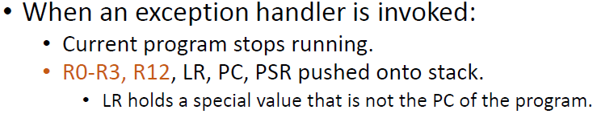
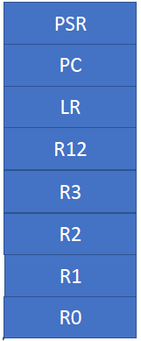



What Happens on an Exception
8

Slide 9
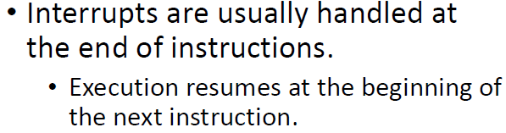
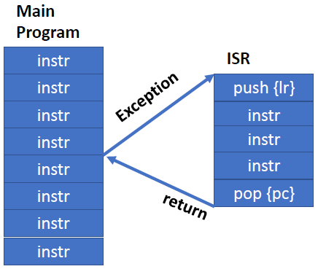
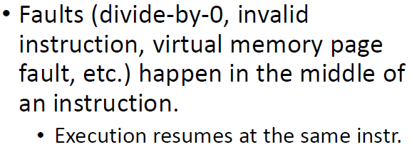
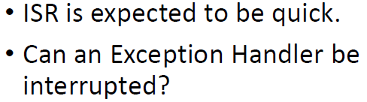
Exception Flow
9

Slide 10
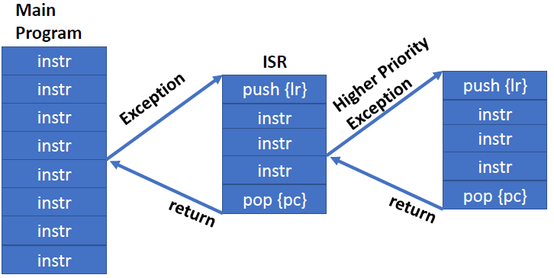

Nested Exceptions
10

Slide 11
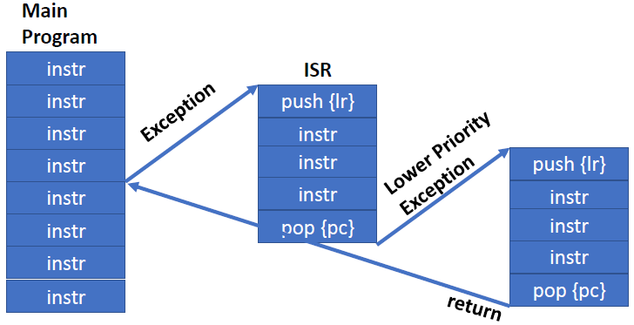
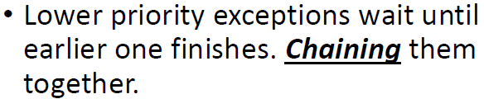
Pending Exceptions
11

Slide 12
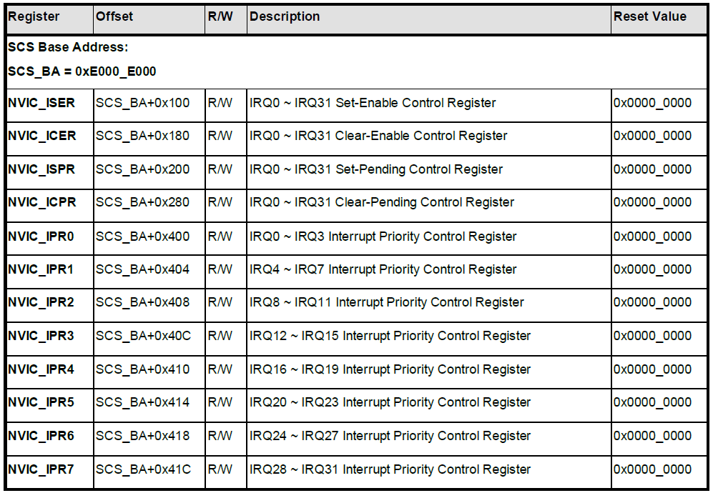
NVIC Control Registers
12

Slide 13
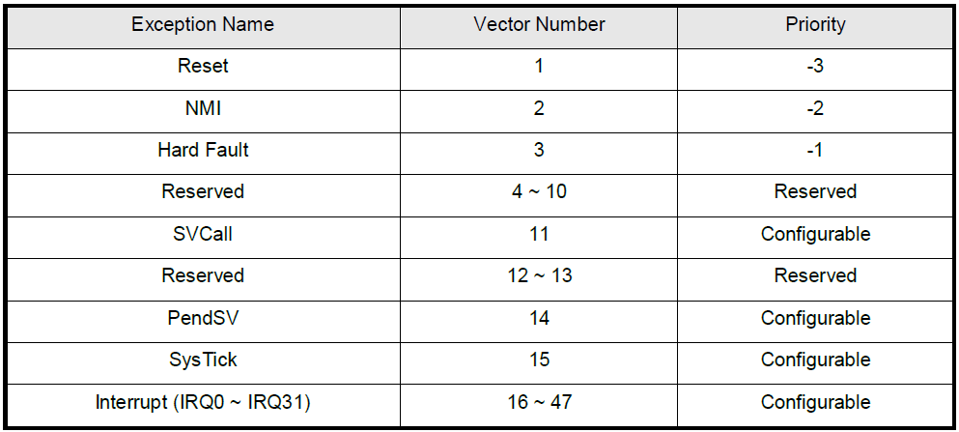
System Interrupt Map
13

Slide 14
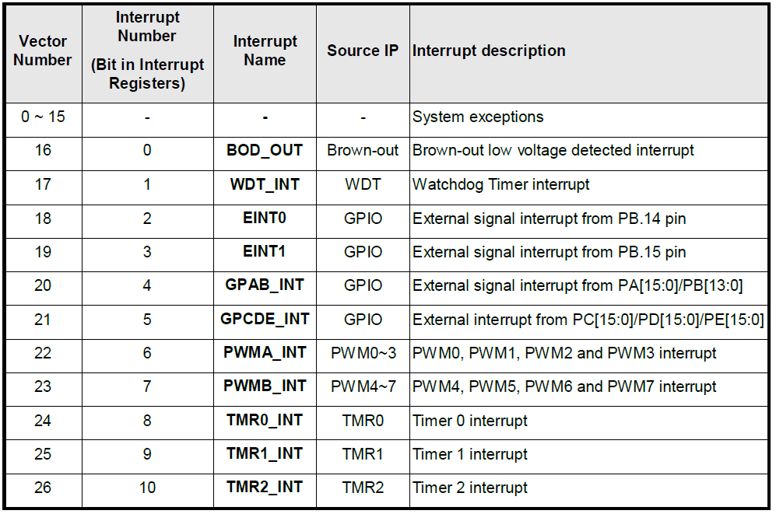
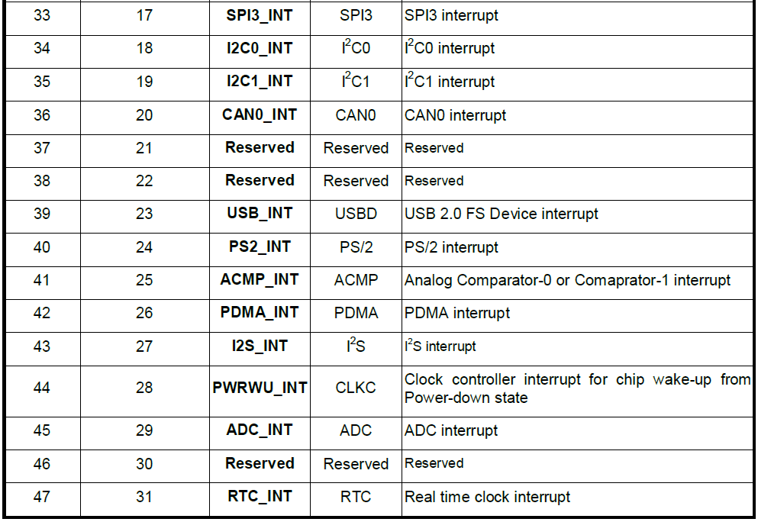
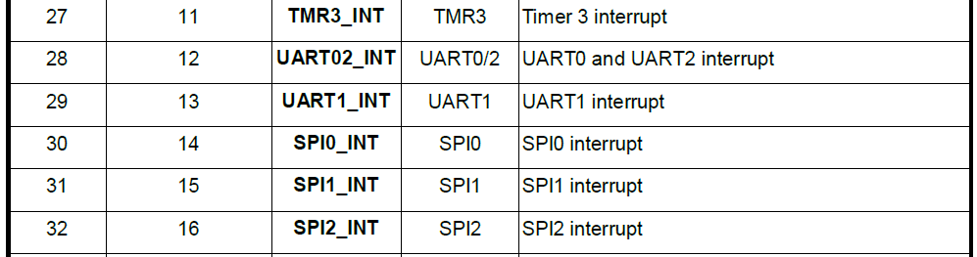
System Interrupt Map
14

Slide 15
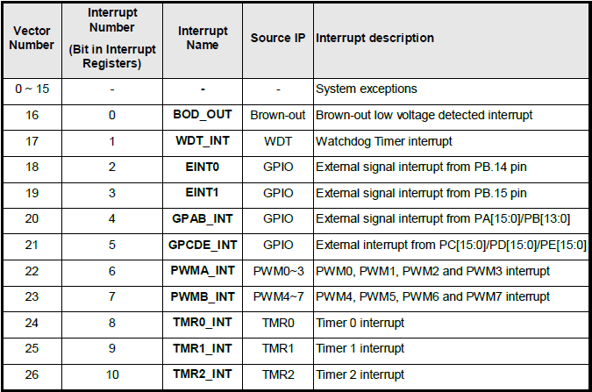
GPIOs Generate Exceptions
GPIO pins can configured to generate exceptions (interrupts).
There are four types of interrupt condition can be selected: low level trigger, high level trigger, falling edge trigger and rising edge trigger.
For edge trigger condition, user can enable input signal de-bounce function to prevent unexpected interrupt happened which caused by noise.
15

Slide 16
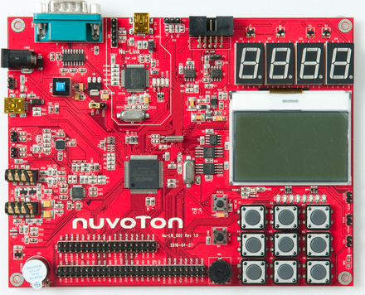
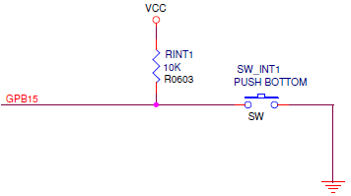
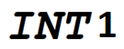
EINT1 on Learning board
16

Slide 17
GPIO Interrupt pin setting
GPIO pin mode : Input
GPIO_SetMode(PB, BIT15, GPIO_MODE_INPUT);
GPIO interrupt trigger type : RISING/FALLING/BOTH_EDGE/HIGH/LOW
GPIO_EnableEINT1 (PB, BIT15, GPIO_INT_FALLING);
GPIO Interrupt :
NVIC_EnableIRQ(EINT1_IRQn);
GPIO pin debouncing:
Debounce Clock Source = LIRC (10KHz) or HCLK
GPIO_SET_DEBOUNCE_TIME(GPIO_DBCLKSRC_LIRC, GPIO_DBCLKSEL_64);
GPIO_ENABLE_DEBOUNCE(PB, BIT15);
17

Slide 18
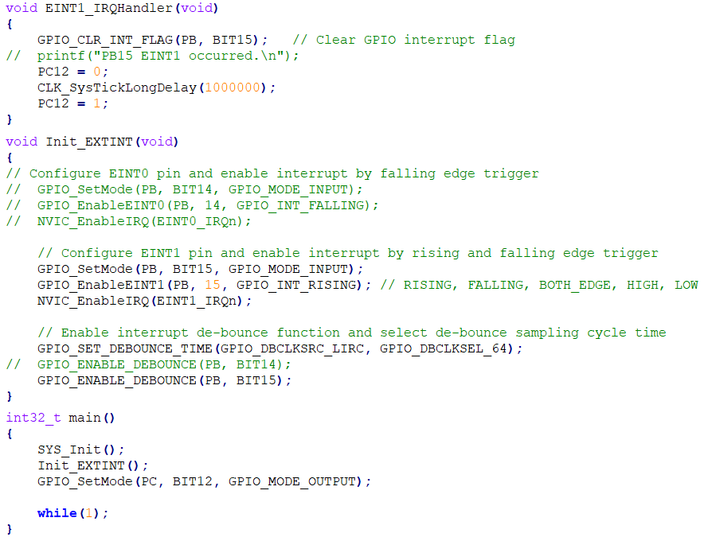
SampleCode: GPIO_ExtInt (with modification)
INT0 /PB14 : unstable, not recommended
INT1 /PB15 :
18

Slide 19
GPIO Interrupt pin setting
GPIO pin mode : Input
GPIO_SetMode(PA, BIT12, GPIO_MODE_INPUT);
GPIO interrupt trigger type : RISING/FALLING/BOTH_EDGE/HIGH/LOW
GPIO_EnableInt(PA, BIT12, GPIO_INT_FALLING);
GPIO Interrupt groups: AB or CDE
NVIC_EnableIRQ(GPAB_IRQn); // AB group share 1 interrupt to CPU
NVIC_EnableIRQ(GPCDE_IRQn); // CDE group share 1 interrupt to CPU
GPIO pin debouncing:
Debounce Clock Source = LIRC (10KHz) or HCLK
GPIO_SET_DEBOUNCE_TIME(GPIO_DBCLKSRC_LIRC, GPIO_DBCLKSEL_64);
GPIO_ENABLE_DEBOUNCE(PA, BIT12);
19

Slide 20
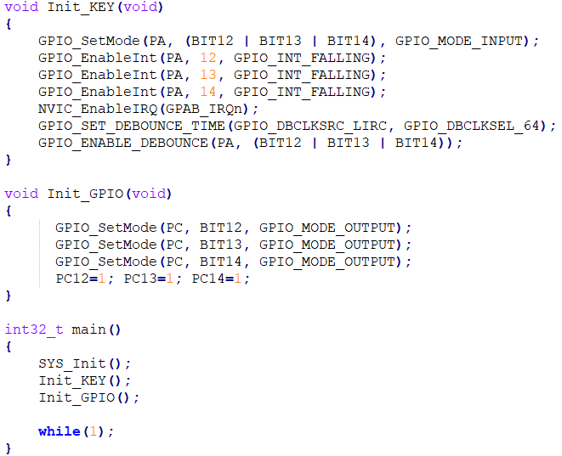
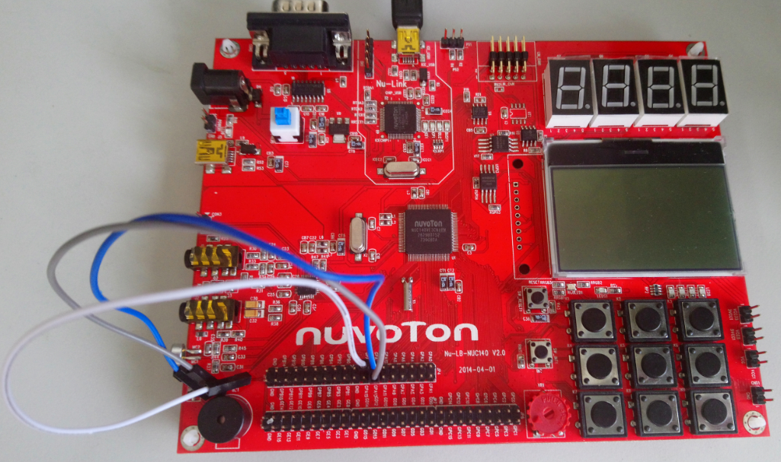
SampleCode: GPIO_IRQ (with modification)
// wire PA12,13,14 to Ground will trigger interrupt
PA12, PA13, PA14
GND
20

Slide 21
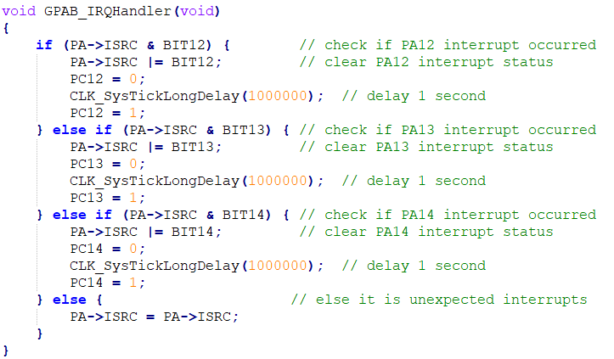
SampleCode: GPIO_IRQ (with modification)
21

Slide 22
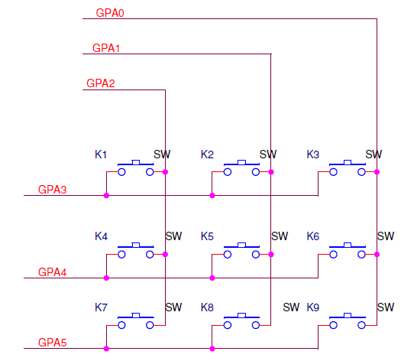
SampleCode: GPIO_IRQ (with keypad)
GPAB_IRQn
0
0
0
22

Slide 23
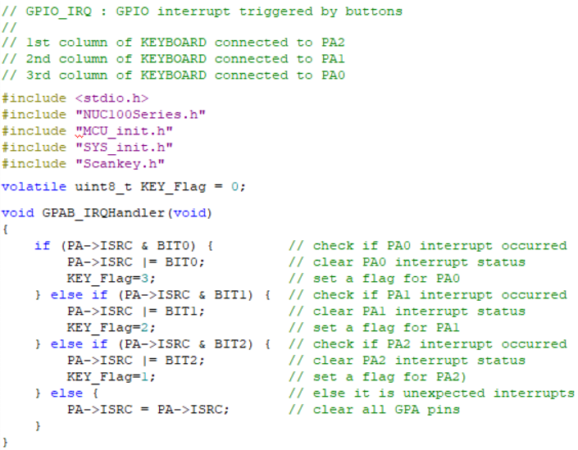
SampleCode: GPIO_IRQ (with keypad)
23

Slide 24
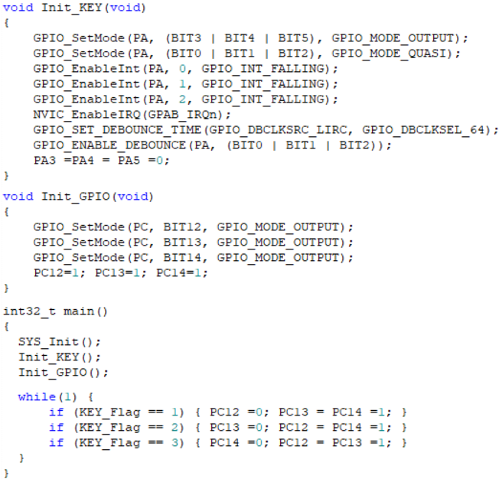
SampleCode: GPIO_IRQ (with keypad)
24

